Slide 1
Learning path dashboard for enhancing skills
CSE7101- Capstone Project
Review-1
Batch Number: CSE_235
Roll Number | Student Name
20221CSE0105 | SIDDARTHA J S
20221CSE0092 | DILIP P
20221CSE0206 | BHAIRESH M N
Under the Supervision of,
Mr. Mr.Anand Haridas
Professor
School of Computer Science and Engineering
Presidency University
Name of the Program: Computer Science And Engineering
Name of the HoD: Dr. Asif Mohammed
Name of the Program Project Coordinator: Dr. Jayavadivel Ravi
Name of the School Project Coordinators: Dr. Sampath A K , Dr. Geetha A

Slide 2
Content
Problem Statement
Objectives
Background and Related work for title Selection
Analysis of Problem Statement
Innovation or Novel Contributions
Git-hub Link
Timeline of the Project
References

Slide 3
Problem Statement Number: PSCS_265
Organization: Government of NCT of Delhi
Category : Software
Problem Description: The proposed solution should be able. Instructor shall have educational resources files in different formats like pdf, word, etc. and hyper-links of relevant academic literature Expected solutions: The desired solution is required to:
Learning dashboard showing different reading statistics like reading time of a particular topic. Total finishing time of a particular skill. -The instructor should be able to easily create a learning path along with incorporating learning resources, as mentioned ""inputs."" including videos.
Progress made by the learner should be continuously updated.
The desired solution must follow UX principles

Slide 4
Analysis of Problem Statement
Technology Stack Components:
Frontend (User Interface Layer)
Framework:
React.js (Modern, responsive UI, reusable components)
UI Styling:
Tailwind CSS (for consistent, responsive design)
Charts & Visualization:
Chart.js for progress and reading statistics visualizations.
Video Player Integration:
React Player for embedding YouTube/Vimeo videos
UX Principles:
Accessibility: ARIA standards, semantic HTML
Mobile responsiveness via CSS Flex/Grid
Database (Data Storage Layer)
Relational (for structured learning path & progress data):
PostgreSQL or MySQL
NoSQL (for flexible resource metadata & analytics):
MongoDB (optional hybrid setup)

Slide 5
Analysis of Problem Statement
Backend (Server & API Layer)
Framework:
Node.js + Express.js (lightweight, real-time friendly)
API Type:
REST API or GraphQL (for more flexible queries, especially for progress tracking)
Authentication & Authorization:
JWT (JSON Web Tokens) or OAuth 2.0 for secure logins
Real-Time Tracking & Analytics
Real-time Events:
WebSockets (Socket.IO in Node.js) for live updates of reading time & progress
Analytics & Logging:
Google Analytics / Matomo for usage tracking
Custom tracking tables in the database for per-topic engagement stats

Slide 6
Github Link
Github Link
https://github.com/Siddarthajs2004/Learning-path-dashboard-for-enhancing-skills

Slide 7
Analysis of Problem Statement (contd...)
Software and Hardware Requirements:
Core Features
Instructor Module
Create & edit learning paths.
Upload educational resources:
PDF, Word, PPT, Excel files.
Videos Hyperlinks to academic literature.
Set timelines & prerequisites for each topic.
Learner Module
View assigned learning path.
Access resources in various formats.
Track reading progress and completion percentage.
See estimated finishing time for skills/topics.
Progress Tracking
Track reading time for each topic.
Show total completion time for a skill.
Real-time update of learner’s progress.
Progress visualizations (charts, progress bars).

Slide 8
Analysis of Problem Statement (contd...)
Data & Analytics
Reading statistics (time spent, pages read).
Completion rate per learner.
Average time per skill across all learners.
Instructor analytics dashboard (comparisons, trends).
Exportable progress reports (PDF/Excel).
Backend Functionality
Authentication & Authorization
Role-based access (Instructor/Learner/Admin).
Database Management
Store user profiles, resources, and progress data.
Resource Management
Upload, store, and retrieve files securely.
Real-Time Updates
Use WebSockets or API polling for live tracking.
Data Security
Encryption for files and personal data.

Slide 9
Analysis of Problem Statement (contd...)
Technology Stack Components
Frontend: React.js (with Tailwind CSS or Material UI)
Backend: Node.js + Express.js
Database: MySQL / MongoDB
File Storage: AWS S3, Firebase Storage, or local server storage
Authentication: JWT or OAuth
Analytics & Charts: Chart.js / Recharts
Deployment: AWS / Azure / Vercel / Netlify
Software Requirements
Visual Studio Code
Node.js
MySQL / MongoDB server
Browser (Chrome/Edge)
Postman (API testing)

Slide 10
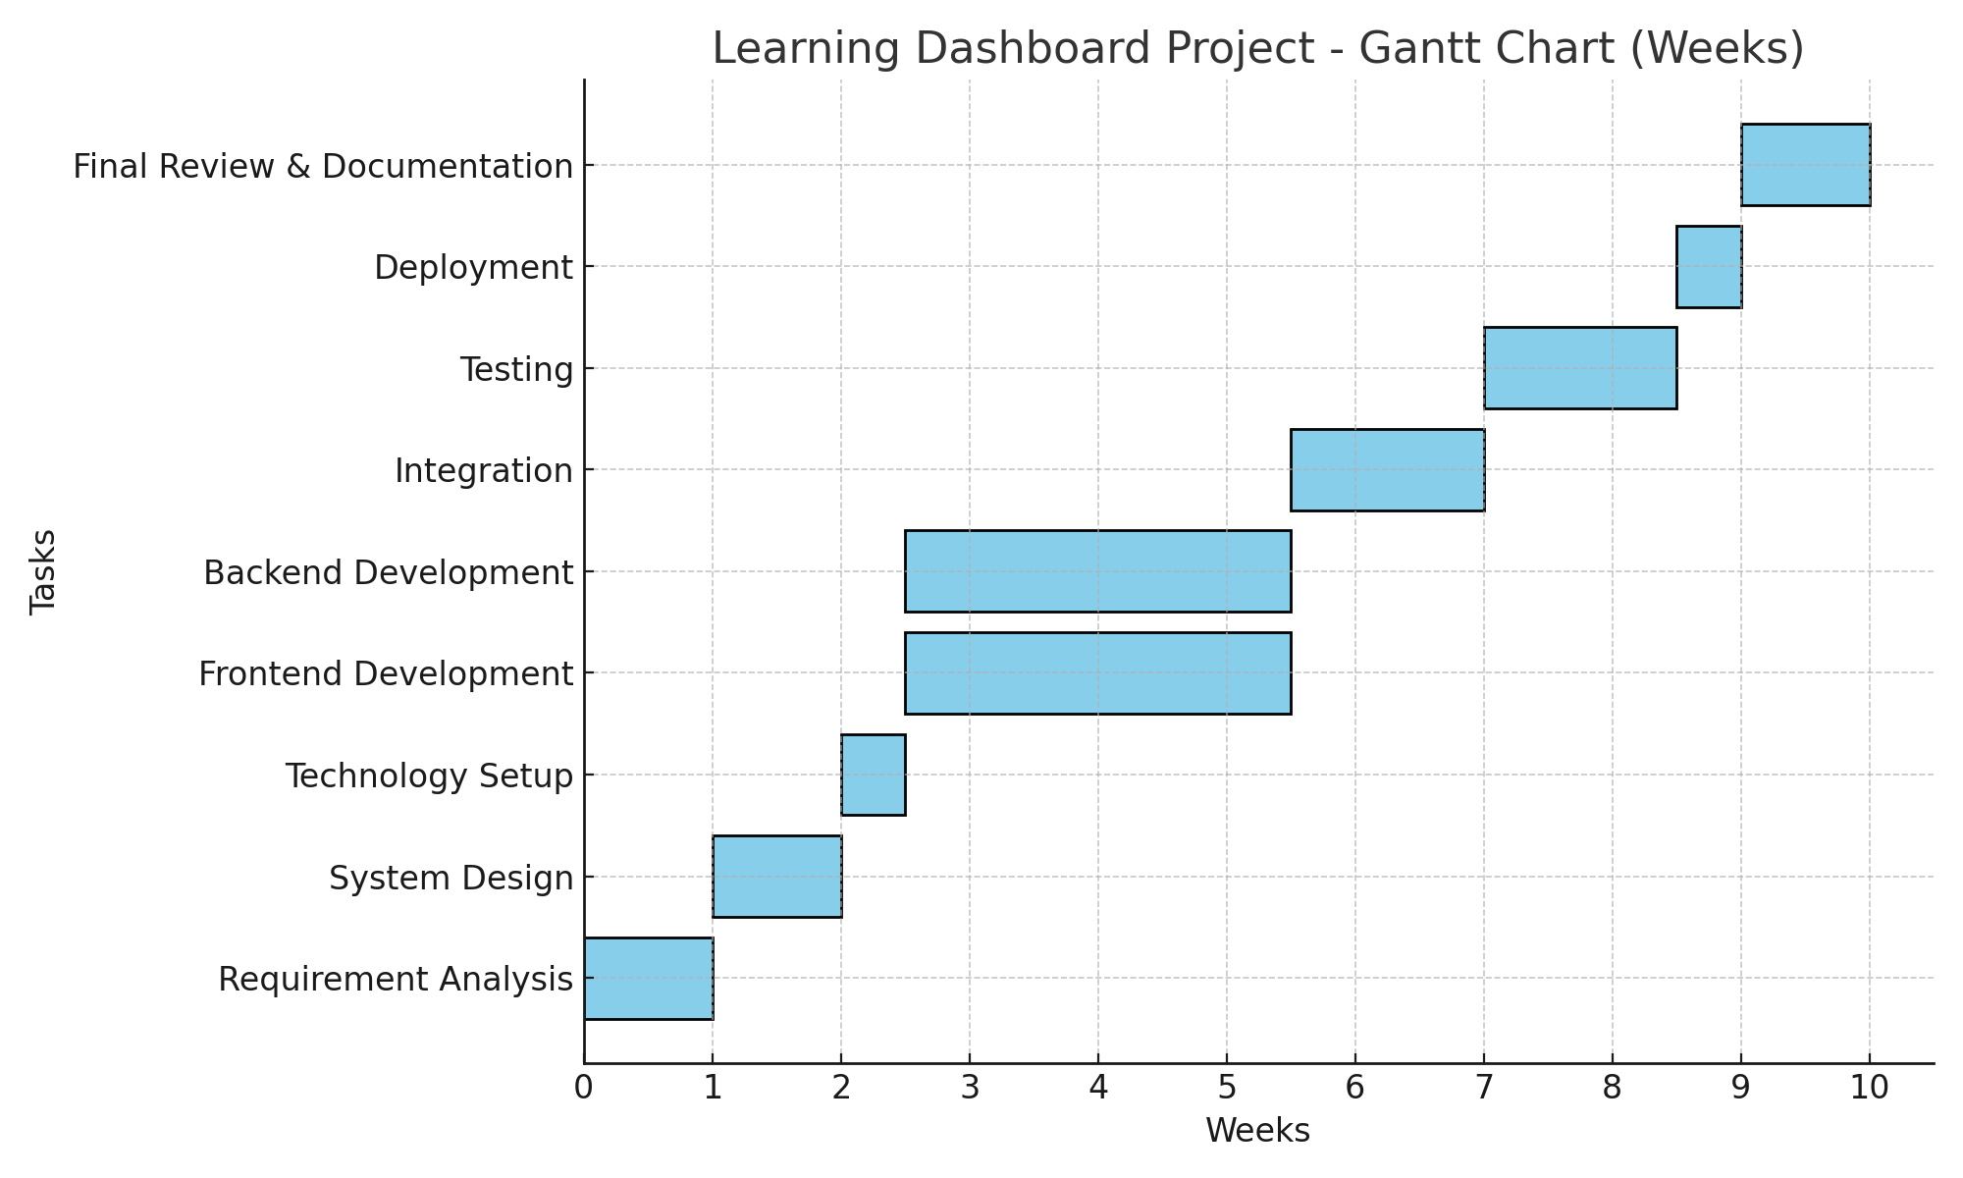
Timeline of the Project (Gantt Chart)

Slide 11
References (IEEE Paper format)
[1] Dilip P, Learning Dashboard: Problem Statement and Proposed Solution, Presidency University, Bengaluru, India, Technical Document, Feb. 2025.
[2] Bhairesh M N, Learning Dashboard: UI & UX Design Principles, Presidency University, Bengaluru, India, Technical Document, Feb. 2025.
[3] J. S. Siddartha, Learning Dashboard: Technology Stack Components, Presidency University, Bengaluru, India, Technical Specification Document, Feb. 2025.

Slide 12
THANK YOU

